Slide 1
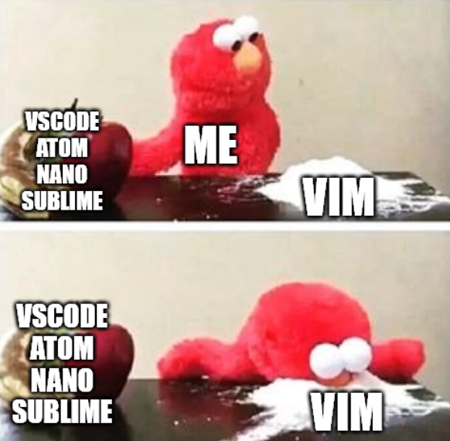

go brrr
Victor Kuo

Slide 2
The schedule tonight…
What is Vim?
Why use Vim?
Vim crash course
Tips to make Vim more useable!
Plugins
Computer settings
Tmux
Quality of life shell tweaks

Slide 3
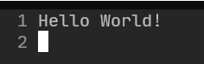
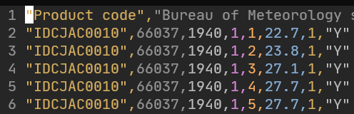
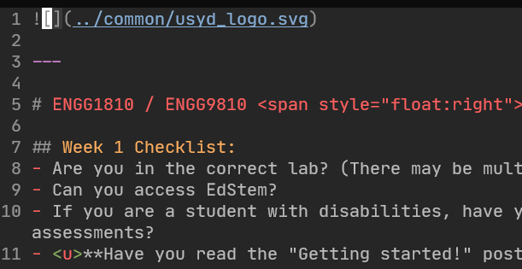
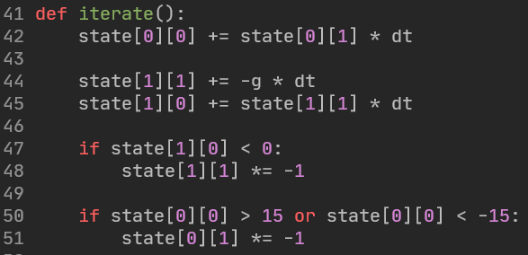
What is VIM?
A text editor!
Edits anything that is stored as raw text
E.g.
Text files
CSV files
Markdown files
Latex files
Source code (no matter the language!)

Slide 4

But what is a text file?
Raw text.
Letters, numbers, symbols, etc.
No images, fancy colouring, groupings, etc.
What about binary files?

Slide 5
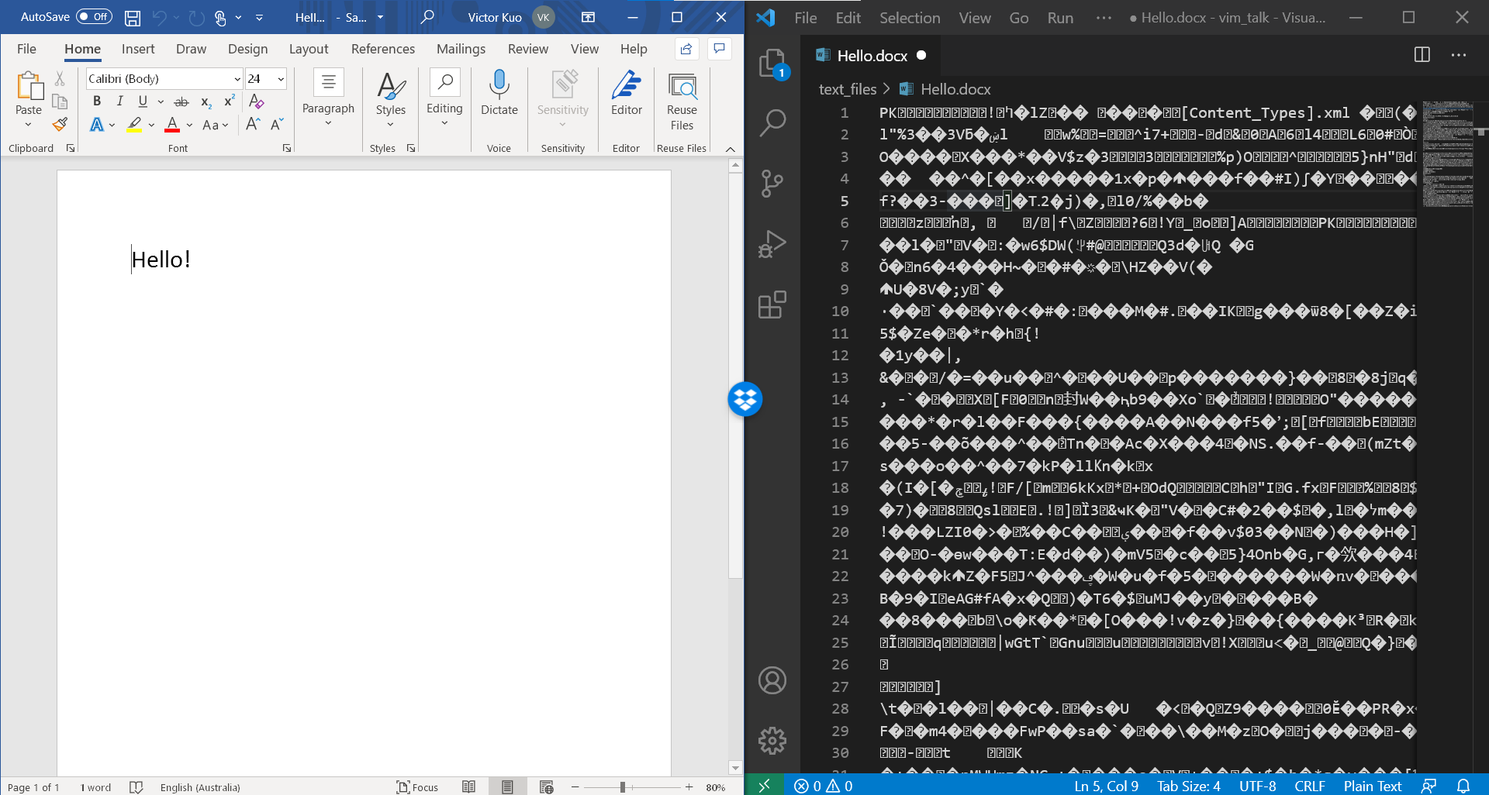

Slide 6
Why learn to edit text files when we have “better” software?
Text files:
Will never disappear.
Fully standardised across the world.
Viewable and editable by any format abiding editor.
Binary files:
Regularly change versions, format, styles, contents.
Hide away your actual contents in binary form.
You’re at the mercy of the software provider.
(This is not to say that binary files are bad, or that proprietary software is bad)

Slide 7








What is VIM?
A text editor!
Essentially, the same function as:

Slide 8
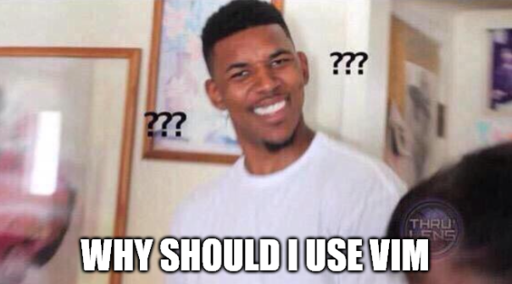
Notes:
Who wants to use regex!?
Middle click hold drag to multiline easier in VSCode.

Slide 9
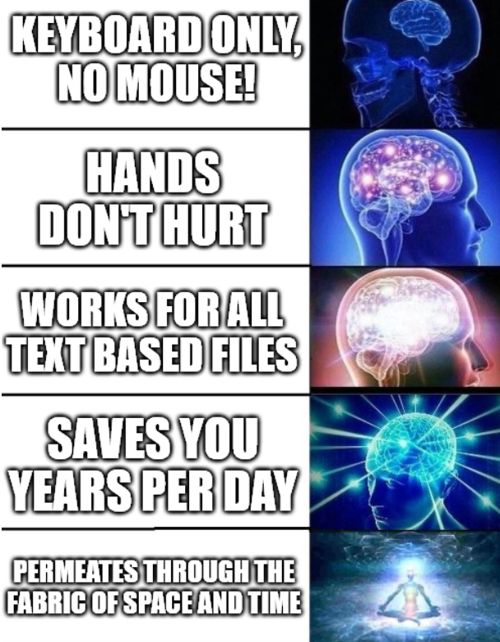
Notes:
Laptop coding is infinitely easier!
Much more intuitive! Commands make sense! Shortcuts make sense…

Slide 10
Let’s get started!

Slide 11
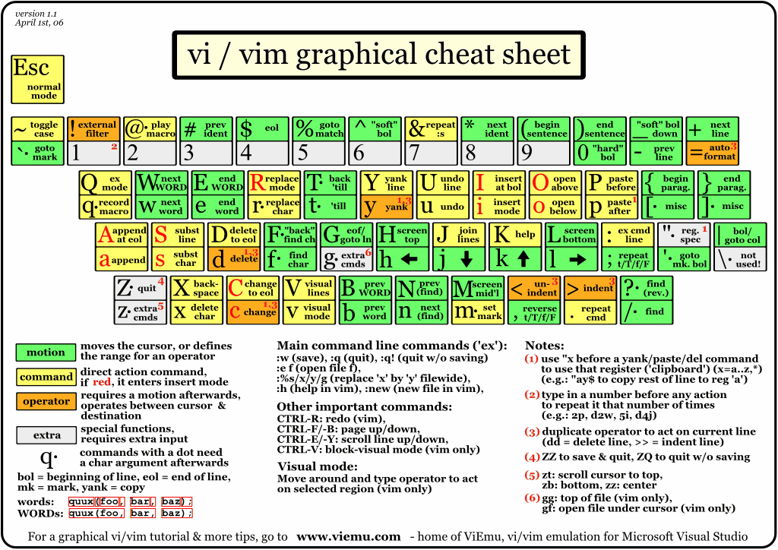
http://www.viemu.com/vi-vim-cheat-sheet.gif

Slide 12
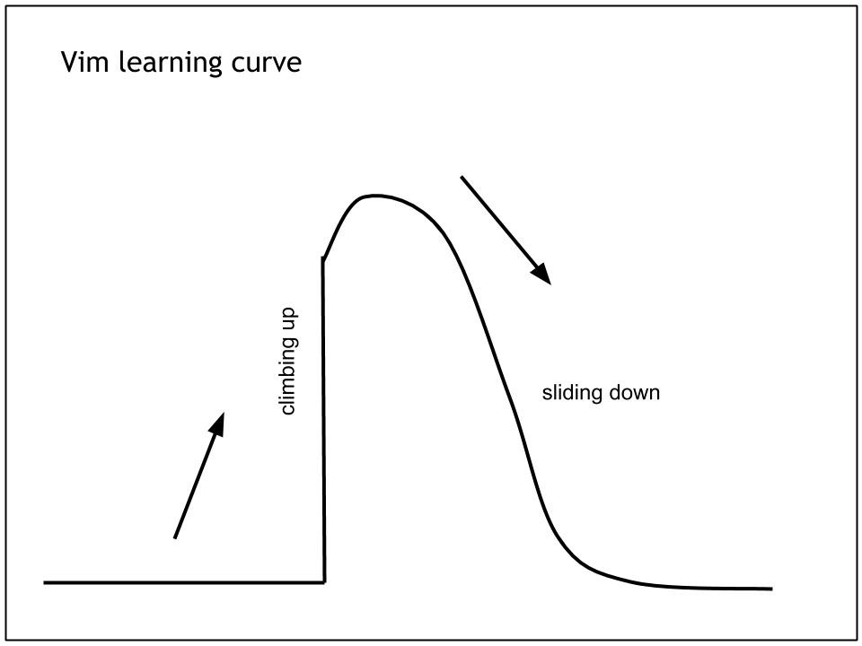

Exiting vim

Slide 13
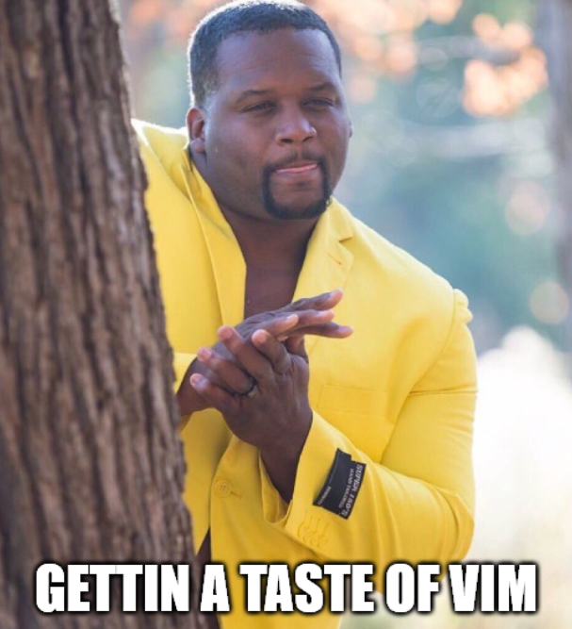
The goal tonight

Slide 14
How to get the most out of this talk…
Sit back, relax, and enjoy!
The goal is to give you guys exposure, to let you know what is out there.
Feel free to download these slides afterwards and try it out on your own ☺.
Taking notes or following along will drain you too quickly and you’ll miss what is really important! (imo at least)
Notes:
10:40m

Slide 15
Let’s actually get started…!
Notes:
18:40

Slide 16
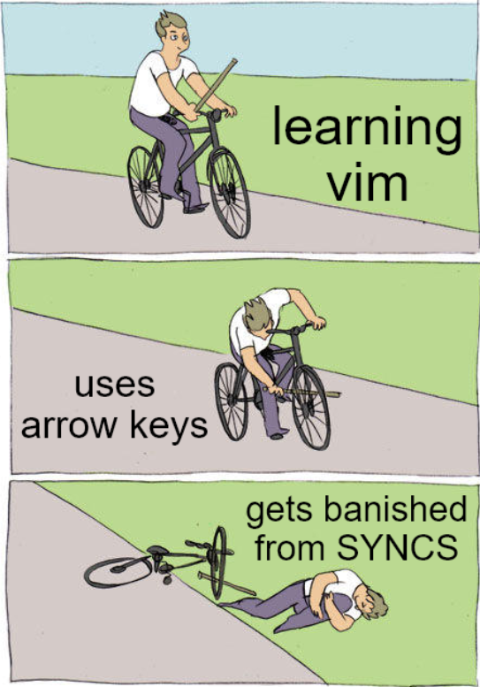

Slide 17
A great way to practise… Vim-be-good

Slide 18
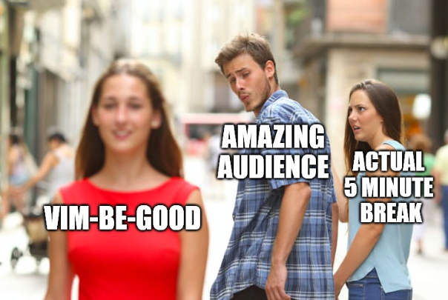
5 minute break!
First 5 people can try VIM-BE-GOOD!
Notes:
23:40

Slide 19
More complex Vim…
Macro
Notes:
33:40

Slide 20
Intermission programming example with application of learnt stuff
Notes:
38:40

Slide 21
5 minute break!
Next 5 people can try VIM-BE-GOOD!
Notes:
23:40

Slide 22
Tips before learning Vim yourself
Remap caps lock to be ctrl
Remap leader to space
Increase the key repeat rate
Decrease the key repeat delay (to start the repeat)
Notes:
46:40

Slide 23
Plugins
Recommended:
Plug 'junegunn/fzf', { 'do': { -> fzf#install() } } " fuzzy find
Plug 'junegunn/fzf.vim'
Plug 'morhetz/gruvbox'
Plug 'tpope/vim-commentary'
Plug 'preservim/nerdtree'
Plug 'tpope/vim-surround'
Plug 'jiangmiao/auto-pairs'
<your language syntax highlighter>
<Intellisense recommend COC>

Slide 24
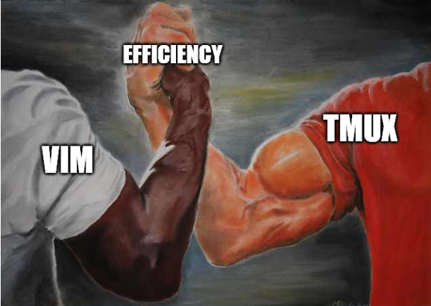
Vim & Tmux
Notes:
51:40

Slide 25
Zsh
Notes:
56:40

Slide 26

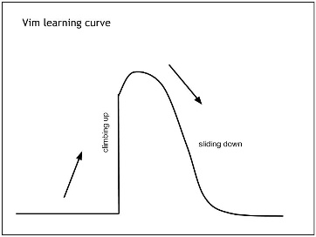
Caveats to using Vim
Live debugging is hard… but there are other ways around it…
Installing your vim plugins and config on a new machine takes a bit longer than installing a single VSCode installer.
Massive productivity drop at the start.
Learning all the basic shortcuts takes time…
Learning all the plugins takes time…
Configuring your new keymaps takes time…
Notes:
60

Slide 27
Closing
Vim is HARD to get started with.
But it’s a long term investment on your hands (and girlfriend 😉).
Always look for easier ways to do things.
Once you see the light, once you come out of the other side of the tunnel, you will emerge a new, woke coder.
Notes:
65

Slide 28
Further study
`vimtutor`
This talk’s recording
The Primeagen https://www.youtube.com/channel/UC8ENHE5xdFSwx71u3fDH5Xw
https://vim-adventures.com/

